Slide 2
System Center Configuration Manager v.Next: Migration from Configuration Manager 2007
Wally Mead, Senior Program Manager
Microsoft Corporation

Slide 3
Agenda for Today’s Session
Migration Overview
Migrating to Configuration Manager v.Next
Migration Scenarios
Object Migration

Slide 4
Terminology
Content:
Package binaries / files
Objects:
Packages, configuration items (DCM), software update deployments, OS images, etc.
Server Settings:
Site role settings and site properties, etc.
Client GUID, inventory, state, etc.
Client Information:

Slide 5







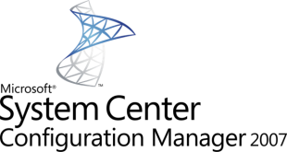
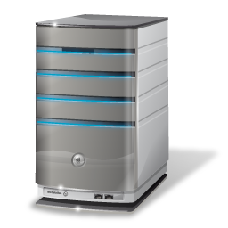



Migration Planning
Clients
Deployment Objects
Inventory & Compliance Data
Server Infrastructure

Slide 6
Comparing Migration
Server Infrastructure
SMS 2003 to ConfigMgr 2007:
Migration occurred top-down when using in-place upgrade
Central sites were upgraded first followed by primary and child primary sites
More than half of the TAP survey respondents used side-by-side migration
Hardware refresh
Start with clean environment

Slide 7
Comparing Migration
Deployment Objects
SMS 2003 to ConfigMgr 2007:
Side-by-side:
To migrate objects customers had to either manually migrate or use scripts
Which objects do I have left to migrate?
How do I prevent content from crossing the WAN?

Slide 8
Comparing Migration
Inventory & Compliance Data
SMS 2003 to ConfigMgr 2007:
Inventory data retained only when performing in-place
With side-by-side this needs to be regenerated

Slide 9
Comparing Migration
Clients
SMS 2003 to ConfigMgr 2007:
Customers used their preferred client deployment mechanisms to perform client upgrades to get to ConfigMgr 2007:
Software distribution, client push, Group Policy, software update, etc.
Which clients do I have to migrate?

Slide 10
Migrating to Configuration Manager v.Next

Slide 11
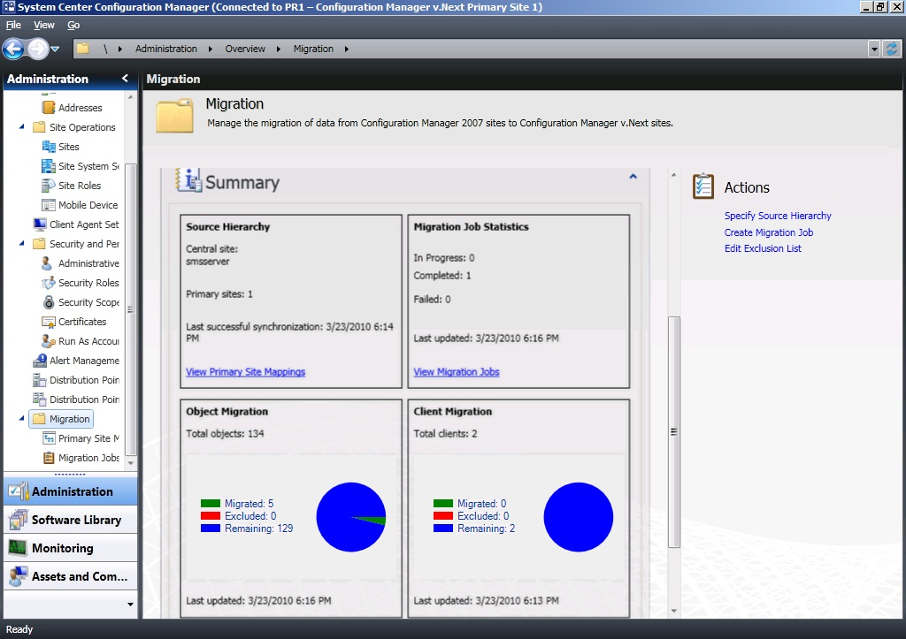
Monitoring Migration in v.Next

Slide 12
Migration Process to ConfigMgr v.Next
Plan
Migrate
Map v.Next to existing ConfigMgr 2007 environment
Migrate Clients
Rinse & Repeat
Test/Proof of Concept
Set up initial v.Next Primary Site(s)
Migrate Objects
Uninstall Configuration Manager 2007 sites
Configure Software Update Point & Synchronize Updates
Design
Deploy
v.Next HW reqs: Windows Server 2008 x64, SQL Server 2008 x64 (SP1 & Cumulative Update 6)
Make sure the hierarchy is operating and software deployment works
Migrate DP
Requires ConfigMgr 2007 SP2
Assess current environment
Set up server roles

Slide 13

Enable Migration in ConfigMgr v.Next
Specify the top level site of the ConfigMgr 2007 SP2 hierarchy in ConfigMgr v.Next:
ConfigMgr v.Next gathers hierarchy and client information from ConfigMgr 2007 to set the baseline
Information is retained in ConfigMgr v.Next for reporting and displaying progress
2007
HQ CS
HQ
CAS
v.Next
EMEA PS
USA PS
EMEA
PS
USA
PS
USA-SEA
PS
France
Sec. Site
USA-SFO
Sec. Site
USA-SEA
Sec. Site
France
Sec. Site
USA-SFO
PS

Slide 14
Primary Site Mapping
ConfigMgr v.Next gathers site specific metadata for objects and distribution points
ConfigMgr v.Next checks the 2007 site(s) every 4 hours for changes and status of distribution points
2007
HQ CS
HQ
CAS
v.Next
EMEA PS
USA PS
EMEA
PS
USA
PS
USA-SEA
PS
France
Sec. Site
USA-SFO
Sec. Site
USA-SEA
Sec. Site
France
Sec. Site
USA-SFO
PS

Slide 15
Specify source hierarchy and mapping primary sites
demo

Slide 16

Migration Jobs
Object migration by type/instance
Enables admin to cherry pick objects to migrate
Object migration by collection
Enables admin to include all related objects for a collection and all objects targeted to the members of the selected collection
Objects can be excluded so they are not automatically selected for subsequent jobs

Slide 17

Distribution Points
Migration goal of minimizing WAN impact:
ConfigMgr 2007 distribution points sharing with ConfigMgr v.Next environment
Clients can retrieve content for packages which have been migrated to ConfigMgr v.Next from ConfigMgr 2007 DP’s
ConfigMgr 2007 distribution points and their properties are surfaced in Migration/Primary Site Mapping node

Slide 18
Defining and executing migration jobs
demo

Slide 19
Client Migration
Clients retain execution history on upgrade
Avoids re-running advertisements
Use your preferred deployment method
Client push installation, software distribution, Group Policy, Windows Software Update Services (WSUS), manual installation, or Operating System Deployment (OSD)
Minimum supported client versions
Windows XP SP2 (64-bit) & SP3 (32-bit), Server 2003 SP2, Vista SP1, Windows 7 RTM, Server 2008 SP2, Server 2008 R2 (64-bit)

Slide 20
Inventory & Compliance data
Recreated when clients start reporting into ConfigMgr v.Next environment
Reduce network/server load by using phased approach of re-assigning clients to the new hierarchy
Retain ConfigMgr 2007 data
Use SQL Reporting Services

Slide 21
Migration Process Review
Define Primary Site Mappings top-down
Migrate objects top-down
Migrate clients
Use Decommission Site action when done with a Configuration Manager 2007 site
Stops the recurring sync between sites
Performed bottom up starting with child primary site

Slide 22
Customer Profiles
Migration Examples

Slide 23
Customer Profile #1
“Remote office optimization”
Infrastructure Goal: Minimize ConfigMgr infrastructure to support the remote office locations.
Profile Item | Hierarchy Design Impacts
Company Locations | One campus in Minneapolis metro area and a few satellite offices
Administrators | 1 administrator with other IT responsibilities, limited day-to-day use
System Count | Approximately 5,000 clients
Feature Set Usage | Hardware Inventory every 7 days, deploys software and software updates

Slide 24



Customer Profile #1 – 5000 clients “Remote office optimization”
Corporate Campus
Primary site (3,000 clients)
Local SQL Server
MP, DP (x2), FSP*, SLP*, SUP, SMP, RP/RSP
Sales Office
Only 15 clients
Good connectivity
Branch DP or
BranchCache™
Warehouse
Secondary site (485 clients)
Manage WAN
DP
District Office
Secondary site (1,500 clients)
Manage WAN
MP, DP, SUP, PMP
Configuration
Manager 2007

Slide 25



Customer Profile #1 – 5000 clients “Remote office optimization”
Corporate Campus
Primary site (3,000 clients)
Local SQL Server
MP, DP (x2), FSP*, SLP*, SUP, RP/RSP
Sales Office
Only 15 clients
Good connectivity
Branch DP or
BranchCache™
Warehouse
Standard DP
(485 clients)
Manage downward flow of Content over WAN
District Office
Secondary site (1,500 clients)
Manage upward/downward WAN traffic
SQL Express
MP, DP, SUP, PMP
v.Next

Slide 26

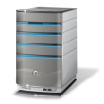


Customer Profile #1
Headquarters
Chicago
Ensure ConfigMgr 2007 SP2 is installed
Install ConfigMgr v.Next Primary
Enable Software Update Point
Specify source hierarchy
Migrate objects
Migrate clients
Uninstall secondary and deploy ConfigMgr v.Next DP
Migrate Warehouse clients to ConfigMgr v.Next
Uninstall secondary and deploy ConfigMgr v.Next secondary
Migrate District clients to ConfigMgr v.Next
Migrate Sales office
Uninstall ConfigMgr 2007 Primary
Sales Office
District
Warehouse
v.Next | 2007 | Site
 |  | Primary Site
 |  | Secondary Site

Slide 27
Customer Profile #2
“Minimize Infrastructure”
Infrastructure Goal: Minimize ConfigMgr infrastructure to support unique remote control settings for the HR department and hardware inventory policies for servers.
Profile Item | Hierarchy Design Impacts
Company Locations | Headquarters in Chicago Subsidiary in London
Administrators | 2-4 administrator with other IT responsibilities, limited day to day use
System Count | Approx. 25,000 clients
Feature Set Usage | Hardware Inventory every 7 days, deploys software and software updates

Slide 28



Customer Profile #2
HR Primary Site
Primary site (300 clients)
Remote Control Disabled
Admin Segmentation
Chicago Central Site
Primary site (~14,700 clients)
Remote Control Enabled
Chicago Campus
15,000 clients
London Desktop Site
Primary site (9,500 clients)
Standard Inventory Policies for desktop
London Servers Site
Primary site (500 clients)
Hardware Inventory Policies unique to Servers
Admin Segmentation
Configuration
Manager 2007
London Offices
9,500 desktops
500 Servers

Slide 29
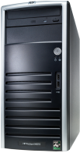
Customer Profile #2
Chicago Primary Site
Primary site (15,000 clients)
Local SQL Server
HR Collection-based settings for Remote Control
Central Admin Site
No Clients
Administration & Reporting for Hierarchy
Admin segment for HR clients
Chicago Campus
15,000 clients
London Desktop
Primary site (10,000 clients)
Inventory Class reporting at Collection level
Admin Segment for Servers
London Offices
9,500 desktops
500 Servers
v.Next

Slide 30

Customer Profile #2
Ensure ConfigMgr 2007 SP2 is installed
Install ConfigMgr v.Next Central Administration Site
Enable Software Update Point
Install ConfigMgr v.Next primary site
Specify source hierarchy
Create Primary Site Mapping
Migrate objects
Migrate clients
Steps 6-8 for HQ Primary Site
Decommission mappings
Uninstall ConfigMgr 2007 primary sites
Headquarters
Chicago
15,000 clients
London
10,000 clients
V.Next | 2007 | Site
 |  | Central Admin Site
 |  | Primary Site

Slide 31
Migration Object and Content Specifics

Slide 32
Software Updates Management
Ensure Software Update Point is configured and Update Repository contains the same updates as Configuration Manager 2007 environment
Wsusutil.exe export/import
Supported by migration:
Conversion of Update Lists to Update Groups
Update Deployments are migrated to Deployments/Groups
Software Update Packages

Slide 33
Software Distribution
Classic Package and Programs are migrated as is:
Use UNC mappings in ConfigMgr 2007 for package source files
App-V:
App-V packages are not migrated in Beta 1
Classic Software Distribution Package/Program is no longer supported in ConfigMgr v.Next
Use new Application Model
Ensure 64-bit clients have the App-V 4.6 client installed before upgrading ConfigMgr client

Slide 34
Operating System Deployment
Supported by migration:
OS Image/Package
Task Sequences
Drivers & Driver Packages
Special cases:
Boot Image source path for beta replaced by default image on ConfigMgr v.Next site due to new WAIK
Beta 1 will not convert client installation package

Slide 35
Settings Management (DCM)
Supported by migration:
Configuration Items and Baselines created by customers & ISV’s
Un-interpreted Configuration Items are not supported
Existing 2007 Config Packs can also be added to ConfigMgr v.Next through Import feature
ConfigMgr v.Next Import will automatically convert 2007 schema to ConfigMgr v.Next schema

Slide 36
Content Migration
Package source files path is migrated as-is
Standardize on UNC paths for package source files
ConfigMgr v.Next clients can obtain content from ConfigMgr 2007 DP’s if requested content is available

Slide 37
Other Objects
Reports are not migrated
Combine reports from both environments
Objects not included in Beta 1:
Asset Intelligence custom catalog
Software Metering Rules
Search and Admin Folders
Software Update Templates
Boundaries
Queries

Slide 38
Prepare for ConfigMgr v.Next
Get to ConfigMgr 2007 SP2
ConfigMgr v.Next System Requirements:
Component | Minimum Requirement
Site Server and Site Roles | Windows Server 2008 (64-bit ) Windows Server 2008 R2 (64-bit)
Datastore | SQL Server 2008 SP1 & Cumulative Update 6 (64-bit)
Distribution Point | Standard DP’s can run on Windows Server 2003 (including 32-bit) with limited functionality
Client | Windows XP SP2 (64-bit) & SP3 (32-bit) Windows 2003 Server SP2 (32-bit & 64-bit) Vista SP1 (32-bit & 64-bit) Windows 7 RTM (32-bit & 64-bit) Windows 2008 SP2 (32-bit & 64-bit) Windows 2008 R2 RTM (64-bit)

Slide 39
Prepare for ConfigMgr v.Next (2)
ConfigMgr v.Next and existing environment can co-exist however ensure the following:
No duplicate site codes
Avoid overlap between 2007 and ConfigMgr v.Next boundaries if using client auto assignment (smssitecode=auto)
Collections:
Avoid mixing user & devices in collection definitions

Slide 40
Prepare for ConfigMgr v.Next (3)
Package Source Path
Use UNC (\\server\myapp\myapp.msi) in package source path instead of local path (d:\myapp)
Determine if ConfigMgr 2007 environment be accessed from ConfigMgr v.Next servers
ConfigMgr v.Next uses WMI, SQL and SMB to retrieve information from the Configuration Manager 2007 environment
Virtualization

Slide 41
Managing ConfigMgr v.Next and ConfigMgr 2007
Create new objects in ConfigMgr 2007 and migrate to ConfigMgr v.Next
Enables sharing of ConfigMgr 2007 Distribution Points with ConfigMgr v.Next clients
Reports need to be generated separately for ConfigMgr v.Next and ConfigMgr 2007 environments

Slide 42

© 2010 Microsoft Corporation. All rights reserved. Microsoft, Windows, Windows Vista and other product names are or may be registered trademarks and/or trademarks in the U.S. and/or other countries.
The information herein is for informational purposes only and represents the current view of Microsoft Corporation as of the date of this presentation. Because Microsoft must respond to changing market conditions, it should not be interpreted to be a commitment on the part of Microsoft, and Microsoft cannot guarantee the accuracy of any information provided after the date of this presentation. MICROSOFT MAKES NO WARRANTIES, EXPRESS, IMPLIED OR STATUTORY, AS TO THE INFORMATION IN THIS PRESENTATION.

